Slide 1
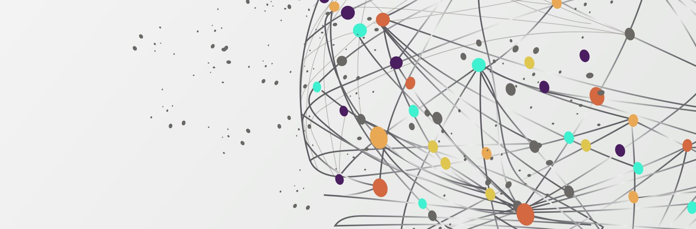
Enhancing Circular Agriculture (ECA): Insects to Connect Crop & Livestock Production
Comparative Analysis of Uncomposted & Composted Frass from Sources X and Y: Impact on Microbial Community Composition in Rhizosphere and Bulk Soil

